Slide 1
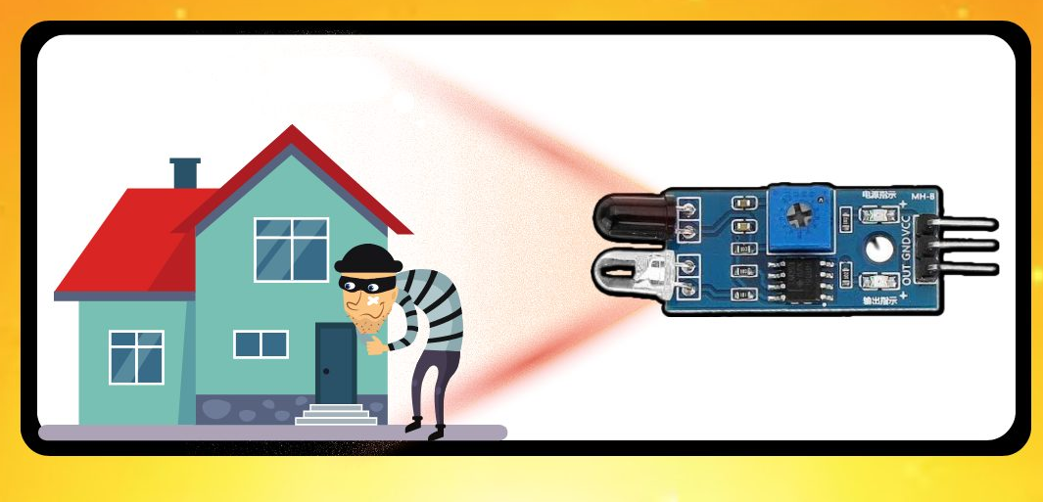
Detection Based Security System
This presentation introduces a comprehensive security system utilizing an array sensors and a robust microcontroller for enhanced protection. The system utilizes a combination of sensors, including ultrasonic, IR, flame, and eye blink sensors, to detect potential threats. These sensors are interfaced with the NodeMCU ESP8266, a powerful and versatile microcontroller, which processes the sensor data and triggers appropriate responses. This system aims to provide a reliable and efficient solution for safeguarding property and individuals.

Slide 2
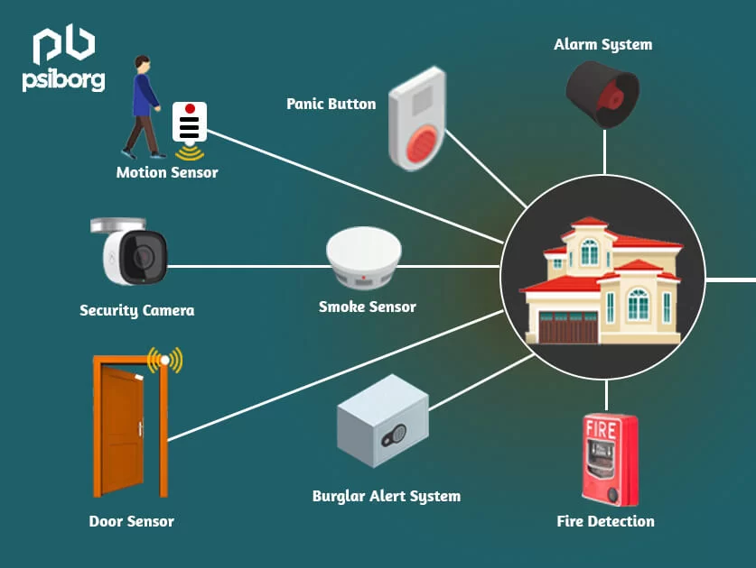
Aim and Objective
The primary aim of this system is to enhance security through the use of advanced sensor technology. The system aims to detect potential threats such as unauthorized entry, fire hazards, and human presence. The system's objective is to provide timely alerts and trigger appropriate actions, deterring potential intruders and ensuring the safety of individuals and property.
1
Early Detection
Utilizing sensors to detect potential threats, including unauthorized entry, fire hazards, and human presence.
2
Alerts & Responses
Triggering alerts and appropriate actions to deter potential intruders and ensure safety.
3
Enhanced Security
Providing a reliable and efficient solution for safeguarding property and individuals.
4
Remote Monitoring
Integrating with a network to enable remote monitoring and control, enhancing situational awareness.

Slide 3
Required Components
The system incorporates various components, each with a specific role in detecting threats and triggering appropriate responses. The core components include the NodeMCU ESP8266 microcontroller, ultrasonic sensor, IR sensor, flame sensor, eye blink sensor, servo motor, buzzer, and jumper wires. These components are carefully selected to ensure reliable and efficient system operation.
Microcontroller
Sensors
Actuators
NodeMCU ESP8266
Ultrasonic sensor, IR sensor, Flame sensor, Eye blink sensor
Servo motor, Buzzer
Processes sensor data, controls outputs, and communicates with other systems.
Execute actions based on microcontroller commands, such as activating alarms or providing warnings.
Detect various threats and provide input signals to the microcontroller.

Slide 4
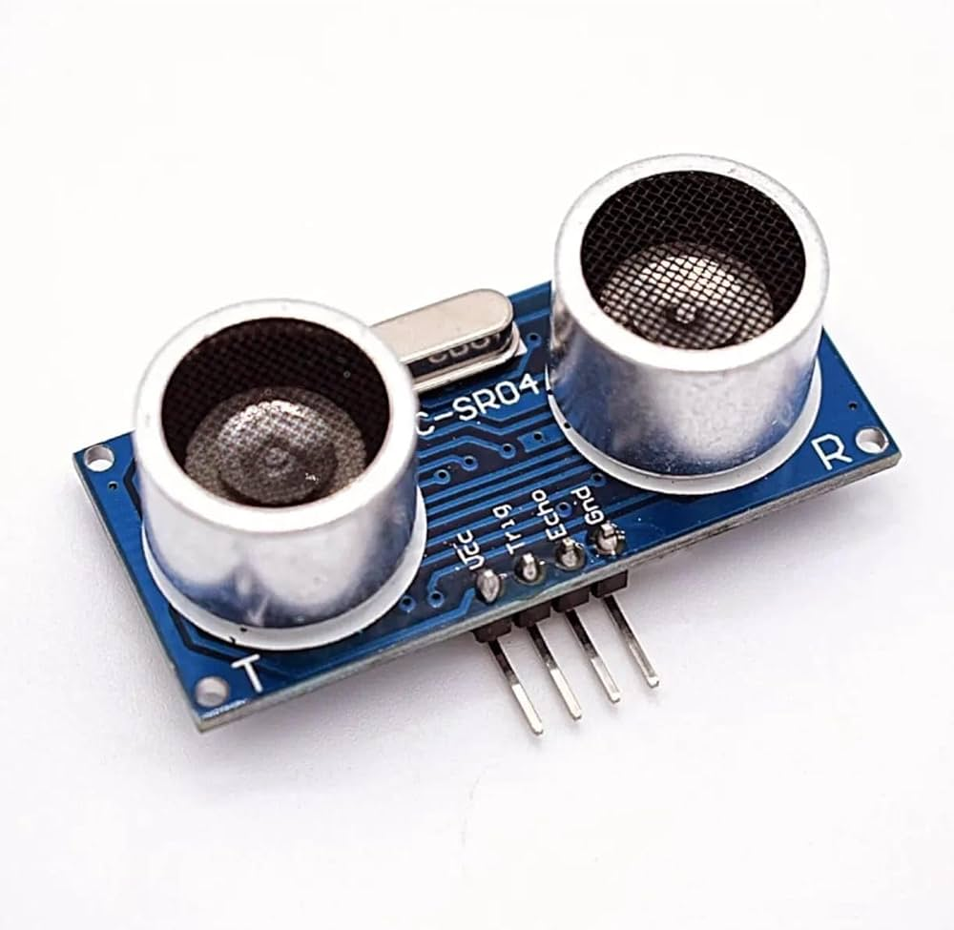
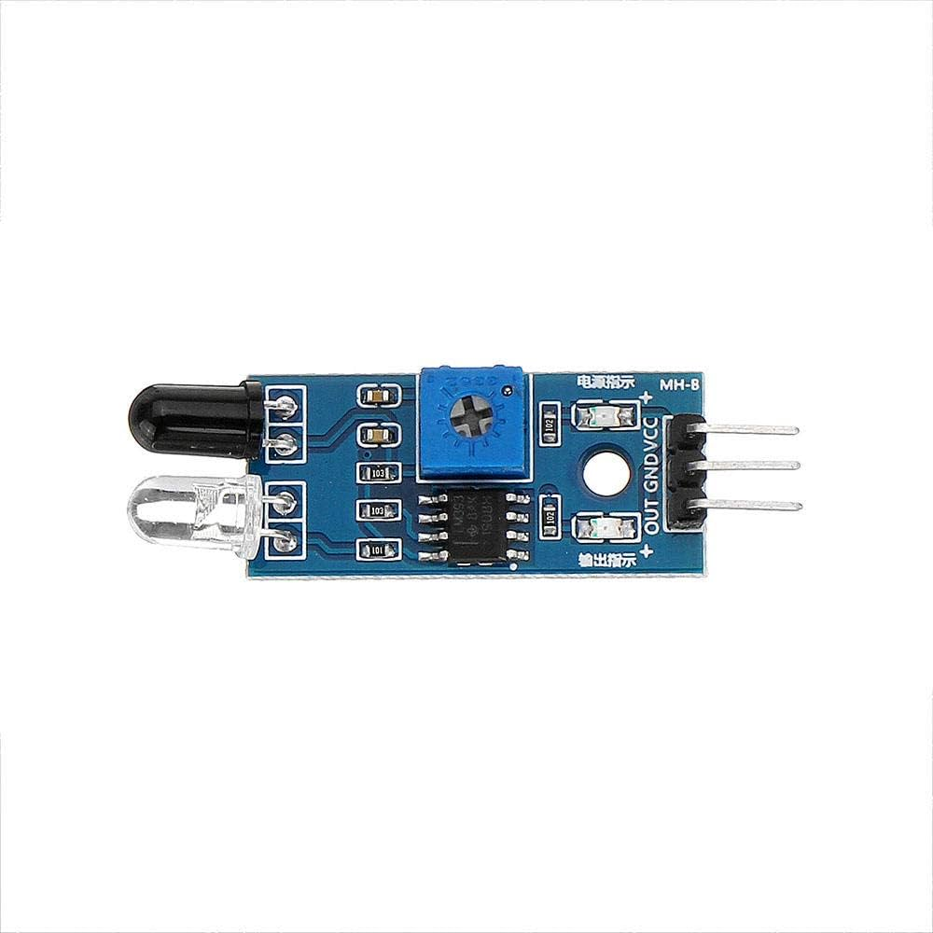
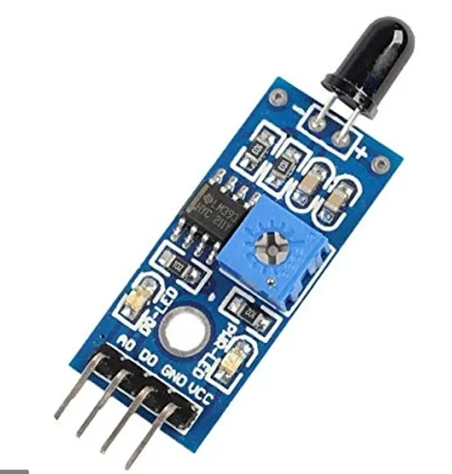
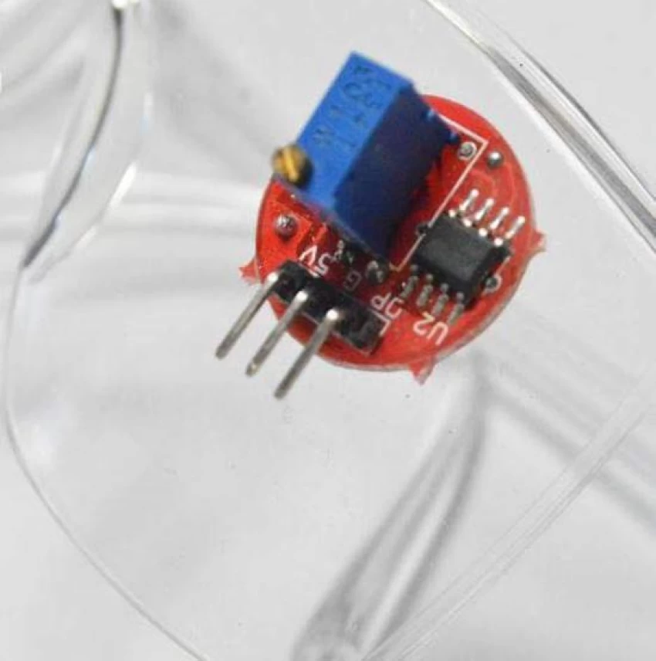

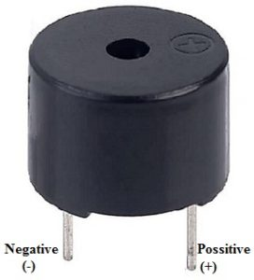
Working Principle of Each Component
Each component in the system operates according to its specific principles, effectively contributing to the overall functionality. The ultrasonic sensor measures distances, the IR sensor detects motion, the flame sensor detects heat, and the eye blink sensor detects eye movements. These sensors provide input signals to the NodeMCU ESP8266 microcontroller, which processes the data and triggers appropriate responses through actuators, such as the servo motor and buzzer.
Ultrasonic Sensor
1
Measures distance using sound waves. Triggers alarms upon detection of unauthorized entry or movement.
2
IR Sensor
Detects motion or interruption of infrared light. Triggers alerts for unauthorized entry attempts.
Flame Sensor
3
Detects the presence of fire or excessive heat. Triggers alarms and activates safety mechanisms.
4
Eye Blink Sensor
Detects eye blinks or movements. Triggers alerts in situations requiring human awareness or interaction.
Servo Motor
5
Controlled by the microcontroller. Used to activate physical barriers or security mechanisms.
6
Buzzer
Activated by the microcontroller to produce audible alarms or warnings, alerting individuals to potential threats.

Slide 5
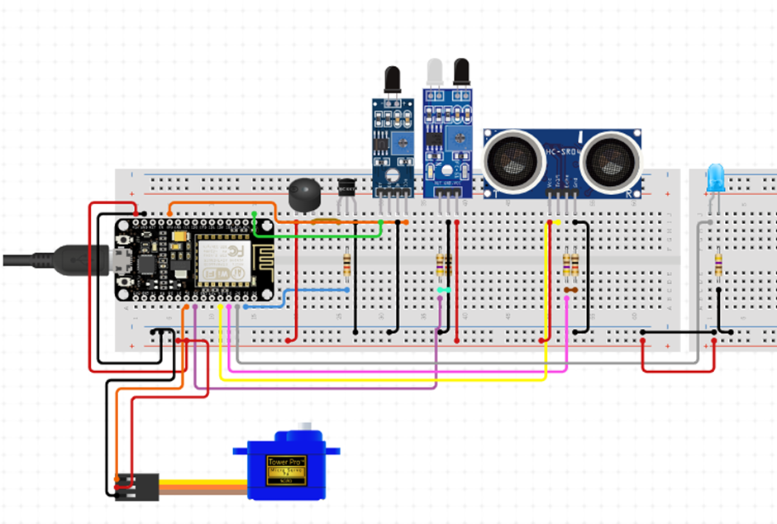
Pin Diagram
The pin diagram illustrates the connections between the microcontroller and various components. The ultrasonic sensor, IR sensor, flame sensor, and eye blink sensor are connected to specific input pins of the NodeMCU ESP8266. The servo motor and buzzer are connected to specific output pins. These connections ensure proper signal flow and communication between the components.
NodeMCU ESP8266
Component
Function
D1
Ultrasonic Sensor (Trig)
Trigger signal
D2
Ultrasonic Sensor (Echo)
Echo signal
D3
IR Sensor
Motion detection signal
D4
Flame Sensor
Heat detection signal
D5
Eye Blink Sensor
Eye blink detection signal
D6
Servo Motor
Control signal
D7
Buzzer
Sound output signal

Slide 6
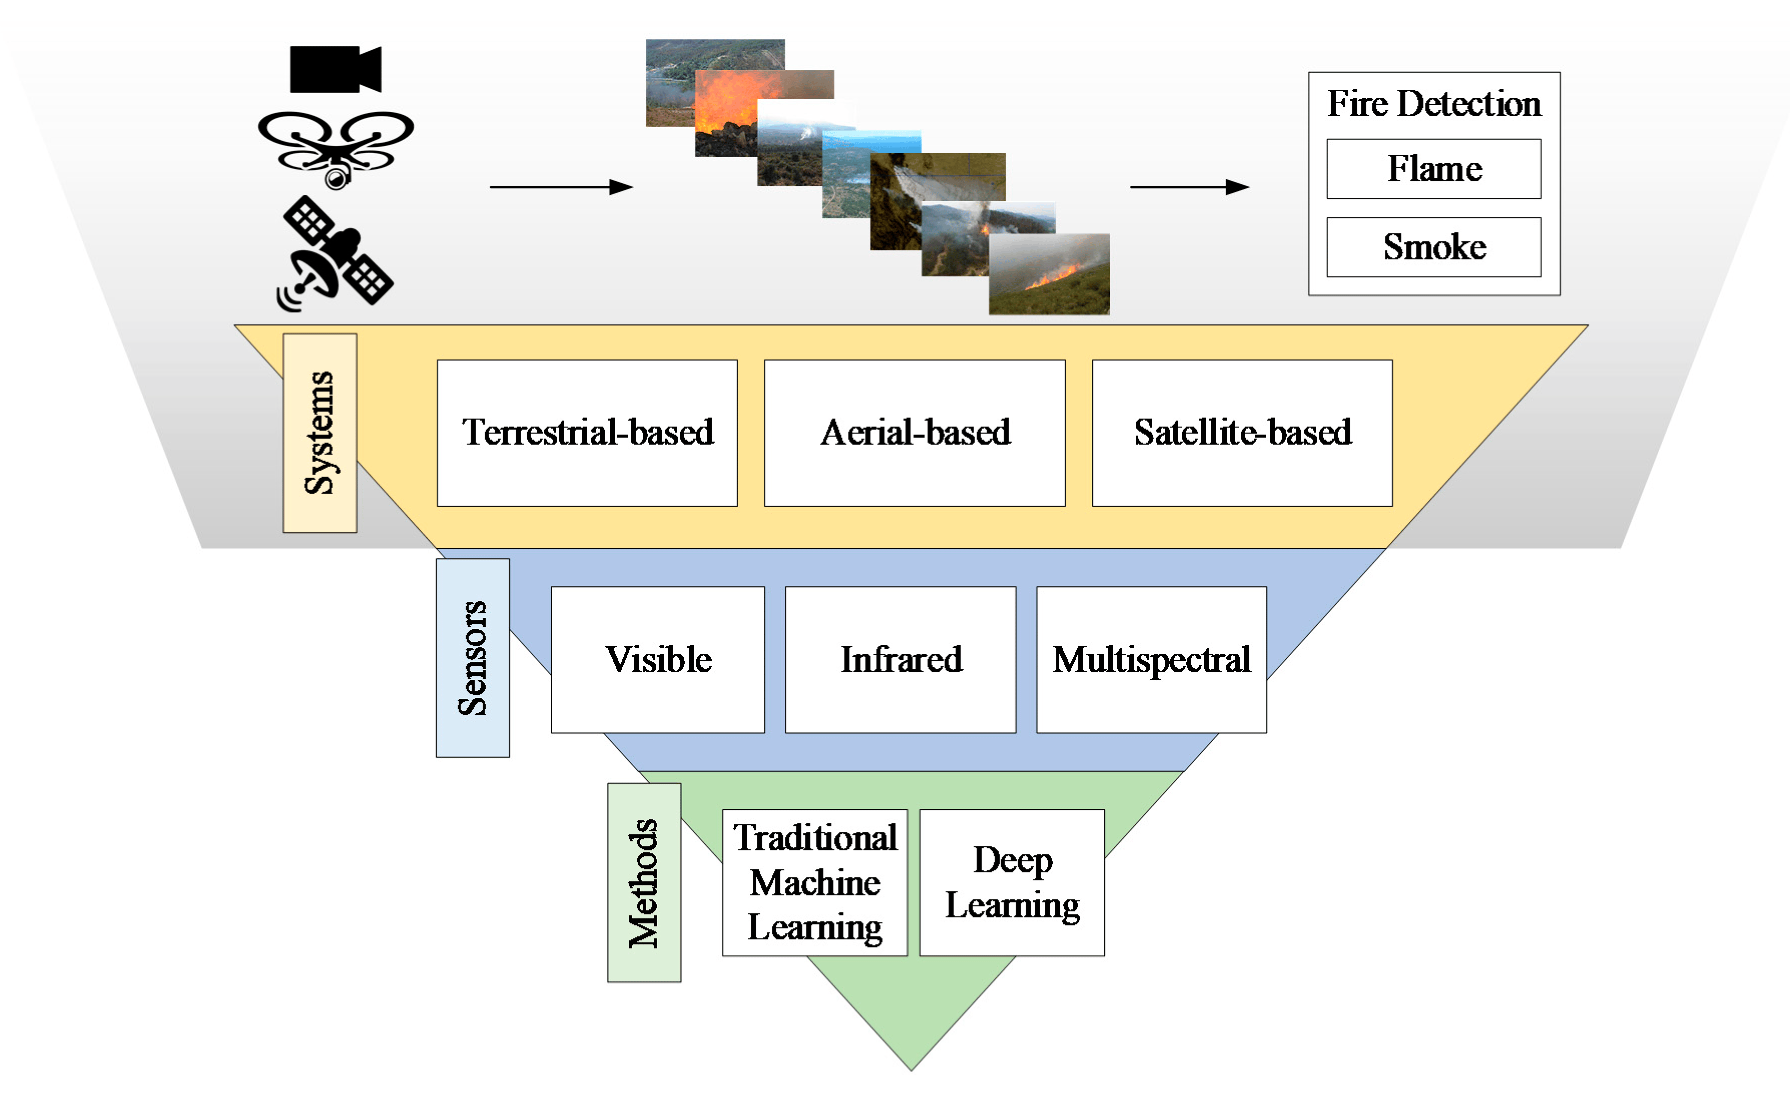
Advantages and Disadvantages
The security system offers a number of advantages, but it also has some limitations. The advantages include enhanced security through the use of multiple sensors, timely detection of threats, and remote monitoring capabilities. The disadvantages include potential false positives, limited coverage area, and the need for regular maintenance and calibration of the sensors.
Advantages
Multiple sensors provide comprehensive threat detection. Timely alerts and responses minimize potential damage. Remote monitoring enables proactive security measures. Cost-effective compared to traditional security systems.
Disadvantages
Potential for false positives can lead to unnecessary alarms. Limited coverage area may leave certain areas vulnerable. Requires regular maintenance and sensor calibration. Susceptibility to interference from external sources.

Slide 7
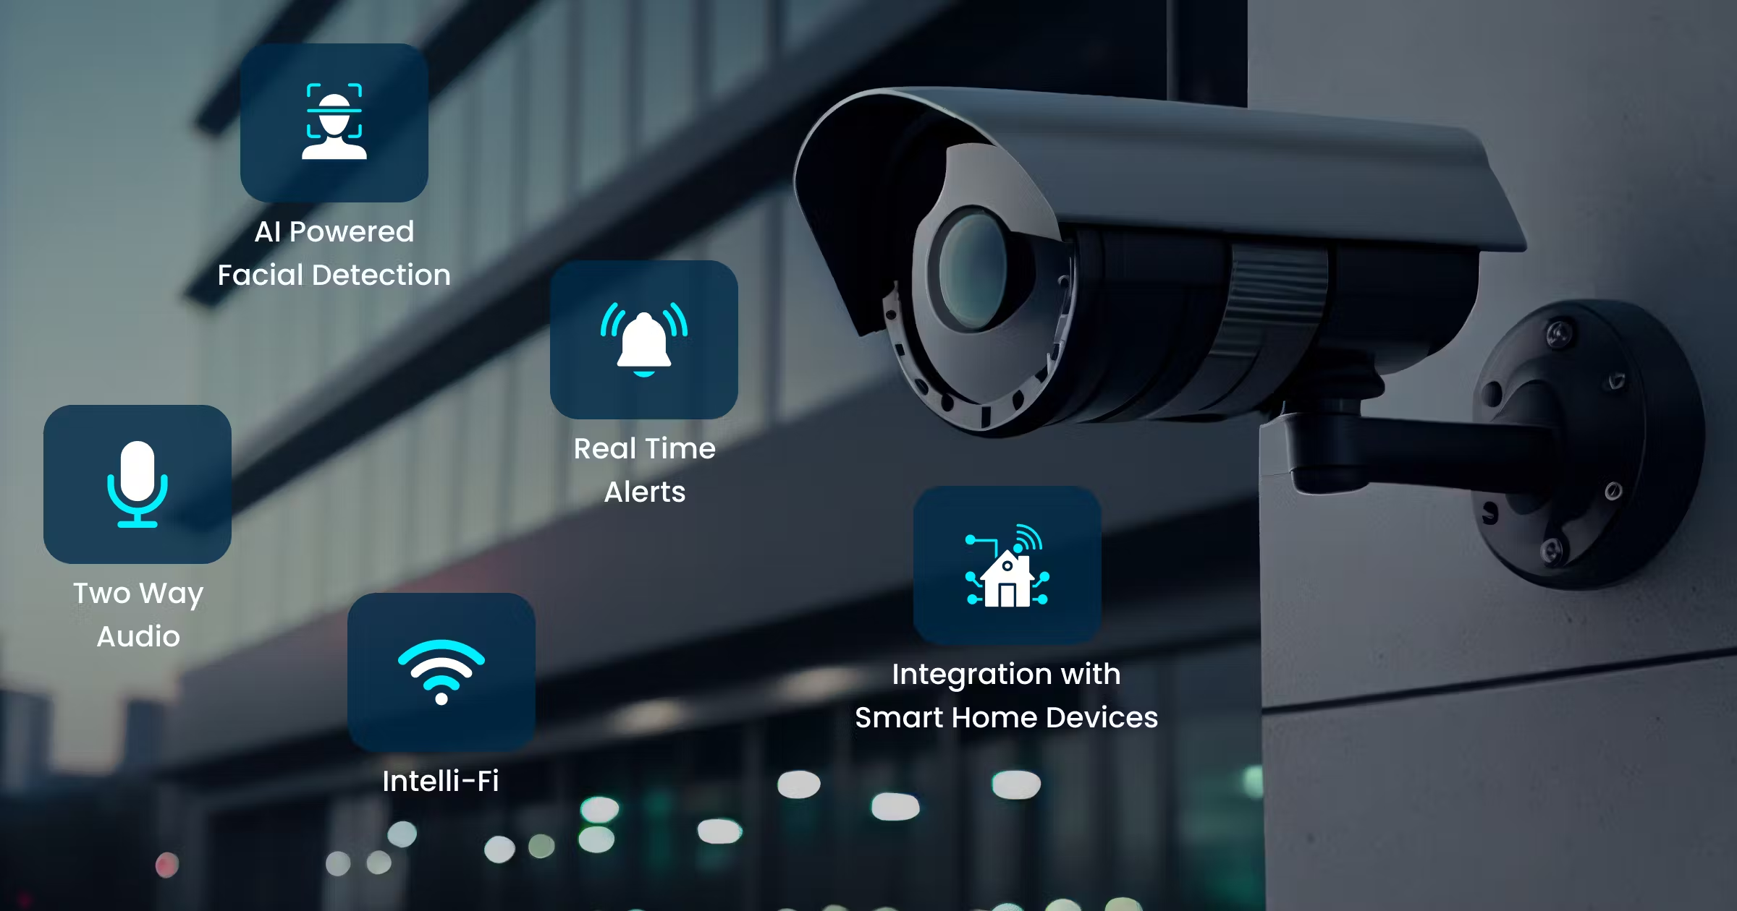



Limitations
The system has certain limitations, primarily due to the physical constraints of the sensors and the environmental conditions. The ultrasonic sensor may be affected by obstacles or reflections, the IR sensor can be affected by ambient light, and the flame sensor's range may be limited by the presence of obstructions. It is important to address these limitations to optimize the system's effectiveness.
Sensor Range
Limited range of sensors restricts the area covered by the system.
Environmental Factors
Sensors may be affected by environmental conditions, such as obstacles, reflections, and ambient light.
Power Consumption
Continuous operation of sensors and microcontroller consumes power, requiring a reliable power source.

Slide 8
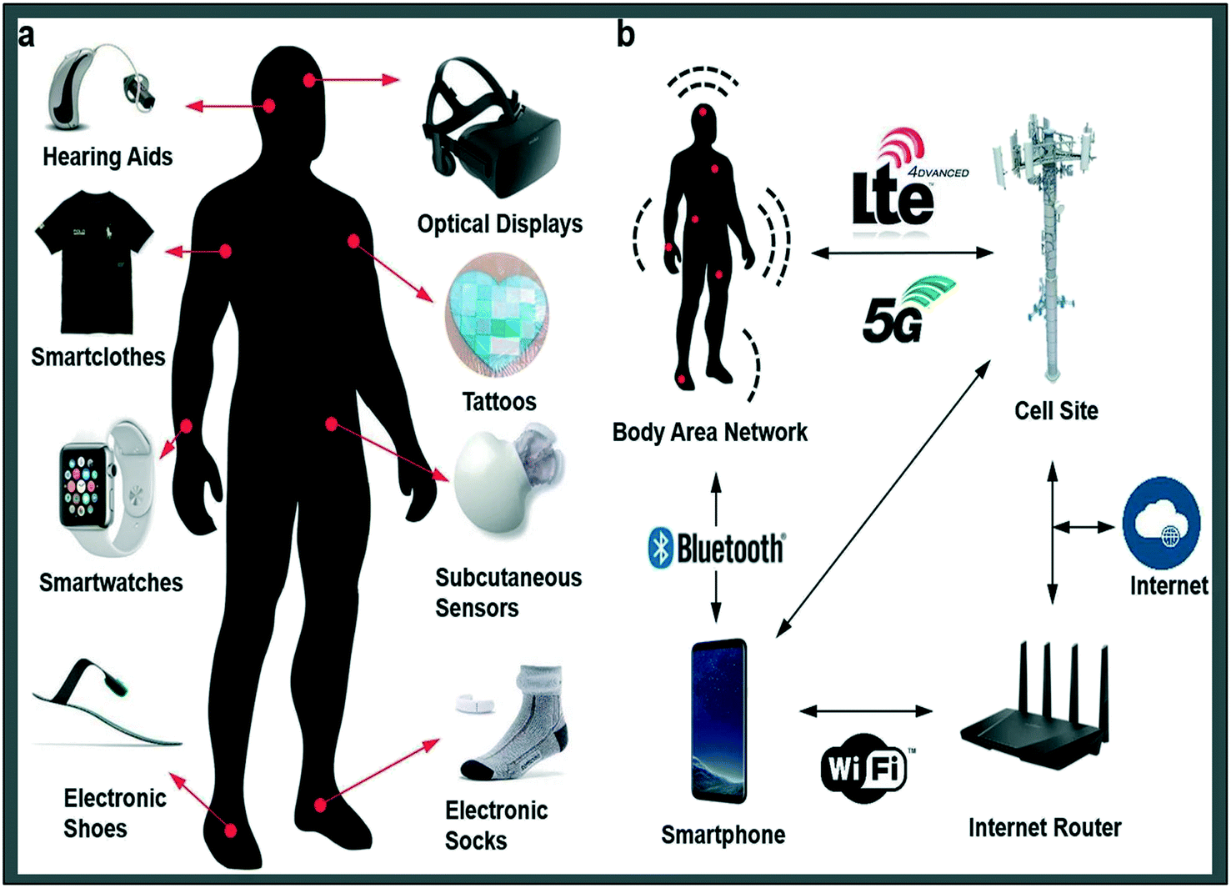



Future Enhancements
The system can be further enhanced by integrating advanced features and technologies. Potential improvements include incorporating a wireless network for remote monitoring and control, implementing image processing for object identification, and integrating with smart home automation systems for seamless integration and control. These enhancements would significantly enhance the system's capabilities and security.
Wireless Connectivity
Enable remote monitoring and control via a wireless network.
Image Processing
Implement image processing for object identification and detailed threat analysis.
Smart Home Integration
Integrate with smart home systems for seamless control and automation.

Slide 9

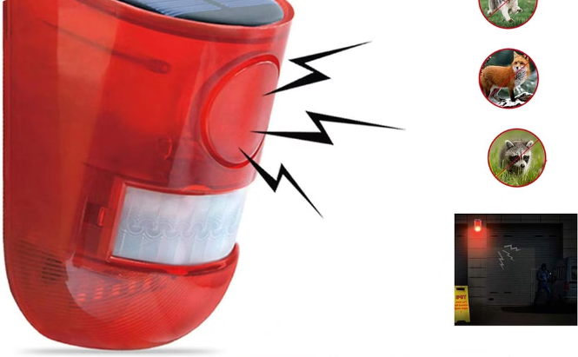

Conclusion
The detection based security system provides a comprehensive solution for safeguarding property and individuals. The integration of various sensors, a powerful microcontroller, and actuators enables timely detection of threats and appropriate responses. The system offers numerous advantages, including enhanced security, cost-effectiveness, and remote monitoring capabilities. However, it also has limitations that require consideration and optimization. With further enhancements, the system can be further optimized and integrated with smart home automation systems for greater convenience and security.
Effective Security
Reliable Detection
Provides a comprehensive solution for safeguarding property and individuals.
Uses sensors to detect potential threats, ensuring timely alerts and appropriate responses.

Slide 10
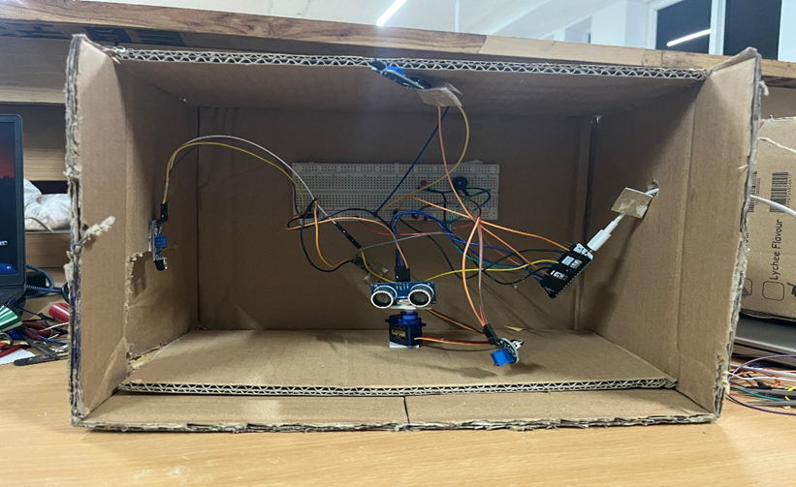
Summary
The presented security system offers a robust approach to enhance security by integrating advanced sensor technology with a powerful microcontroller. The system utilizes a combination of ultrasonic, IR, flame, and eye blink sensors to detect various threats and trigger alerts and actions accordingly. While the system has limitations, it provides significant advantages, making it an effective solution for safeguarding property and individuals. Future enhancements, such as wireless network integration and smart home integration, can further enhance the system's capabilities and provide a more seamless and comprehensive security solution.

